Slide 1


Pragmatic testing
Michael Alberhasky| Senior Application Developer
11/17/2016

Slide 2
Disclaimer
I am not an expert about code testing.
Any resemblance to being an expert is a coincidence.
There are things I could do better.

Slide 3
Unit Tests
Test in isolation
Limited to publically exposed methods in a class
Testing for proper behavior
Checking input/output limits
Least brittle, run the fastest

Slide 4
Integration Tests
Test functionality between classes
Test functionality with external services (DB, file system, web services)
More brittle and run slower

Slide 5
Functional Tests
Test functionality at presentation layer
Verifies the UI is working with the rest of the system
Verifies UI components are working as expected
Most brittle, run the slowest

Slide 6
Different types of tests
Slower
More brittle
User perspective
Functional
Things together
Integration
Things in isolation
Unit
Faster
Less brittle
Source: “Testing End to End” by Jason Roberts - Pluralsight

Slide 7
Other common types of tests
Regression tests (just tests to make sure you don’t break fixes)
Performance/Stress tests

Slide 8
Password Tool
Launched August 2015
Replaced several other password utilities
Vended tool required proactively storing answers to generic challenge questions
Help reduce Help Desk (ITS and Admissions) calls to reset passwords. Over 2,000 calls per month in Q1 2015.
Notes:
Anxis tools cost something like $25,000/year to license and were hardly used

Slide 9
Requirements
Needs to integrate with institutional data sources to provide challenge questions (MAUI, IDW, Active Directory, Duo Enrollment)
Provide immediate feedback on password rules
Two-factor authentication
Needs to be accessible
Good backwards browser compatibility
Ability to blacklist individuals and groups

Slide 10
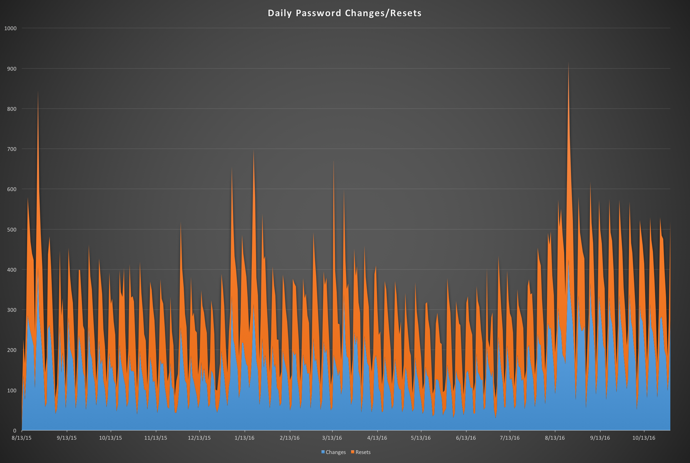
Can you spot the start of the semesters?
Notes:
70,871 Resets, 67,893 Changes as of 11/14 (about 4500 resets per month)
You can easily see the first day of class on there for 2015 and 2016

Slide 11
Initial testing suite
Simple app, not a lot of unit tests
Integration tests for each service gateway
Selenium tests to ensure good browser compatibility

Slide 12
Show the tests
Notes:
For unit test example: show util.PasswordUtilTest
For integration test example: services.DNAClientTest
For selenim example: controllers.selenium.SeleniumChangeTest

Slide 13
What has changed since release
Selenium is a moving target
  I’ve branched those tests as I don’t expect to run them that often
  Selenium 3.0 requires Java 8
  Hard to maintain test VMs
A smattering of regression tests
Light refactoring
Responsive emails required testing
Bamboo build running tests
Notes:
https://www.emailonacid.com/app/acidtest/display/summary/bJEFqbn1gbMD5y1QruiFykUMBSlXR1j9AKpmzYS9t3MV2/shared
https://bamboo.its.uiowa.edu/browse/PWTOOL-BUILD

Slide 14
What would I test differently
Javascript tests using something like Qunit, Karma, Jasmine, etc.
Selenium tests perhaps against iOS and Android as those platforms are evolving faster than the desktop.
Coverage is good, could always be better but most of the bases are covered.
Still manual tests required
  Screen reader
  Email template

Slide 15

Questions?
Notes:
https://github.com/marmelab/gremlins.js

